Slide 1
Exploring CO2 Emissions from the Global Agri-Food Industry
Project Progress Presentation for SML320
By Vassiliki Mancoridis

Slide 2
Background

Slide 3
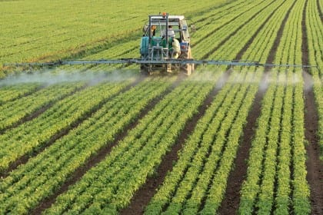
The agri-food industry
Primary production of food… as well as food storage, aggregation, post-harvest handling, transportation, processing, marketing, disposal, and consumption” [1]
Responsible for 62% of total global CO2 emissions [2]
https://www.mentorworks.ca/blog/business-strategy/ontario-agri-food-industry-sustainable-growth/

Slide 4
Description of Data

Slide 5
Agri-food CO2 emission dataset- Forecasting ML [2]
Located this dataset on Kaggle
Constructed from merging/reprocessing a dozen datasets from the Food and Agriculture Organization (FAO) and data from the IPCC
Emissions in units of kt of CO2

Slide 6
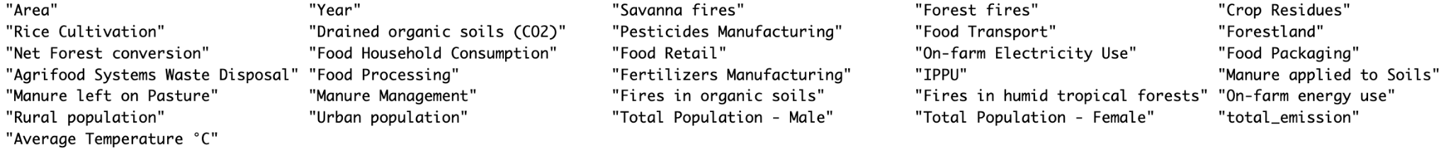
Agri-food CO2 emission dataset- Forecasting ML [2]
6935 rows, 31 columns
Rows ordered by country/area (251 in total)
Notes:
Why? The main reason is that some territories are listed (e.g. Wallis and Futuna Islands)

Slide 7
Exploratory Data Analysis

Slide 8
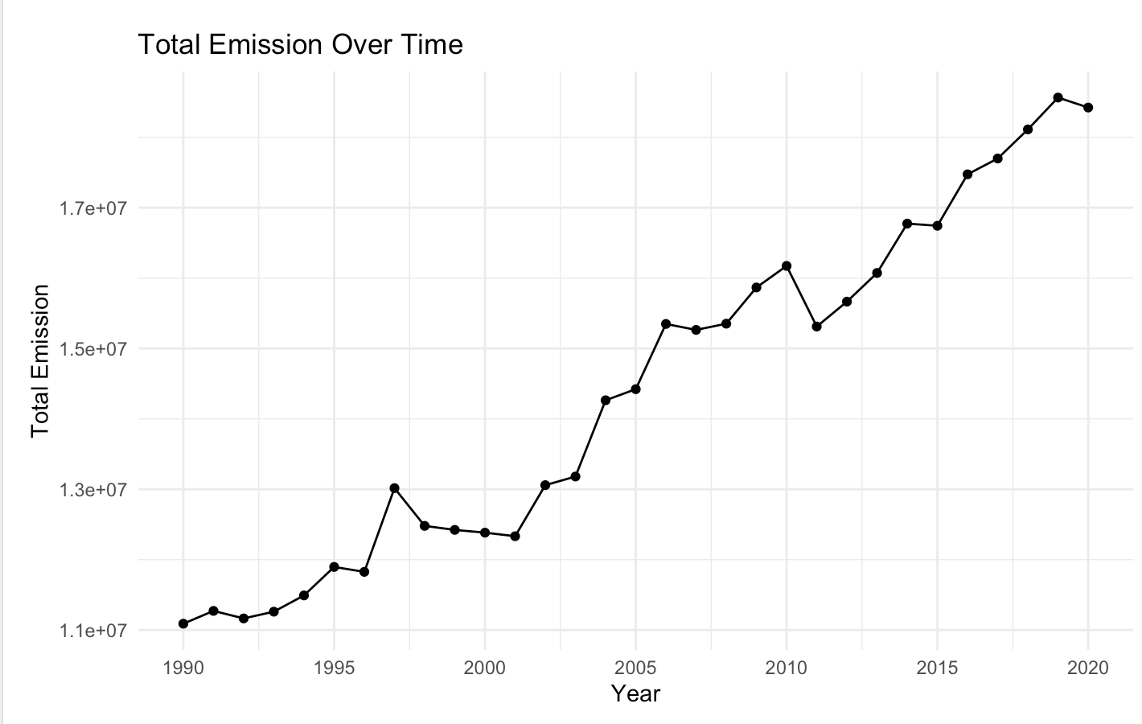
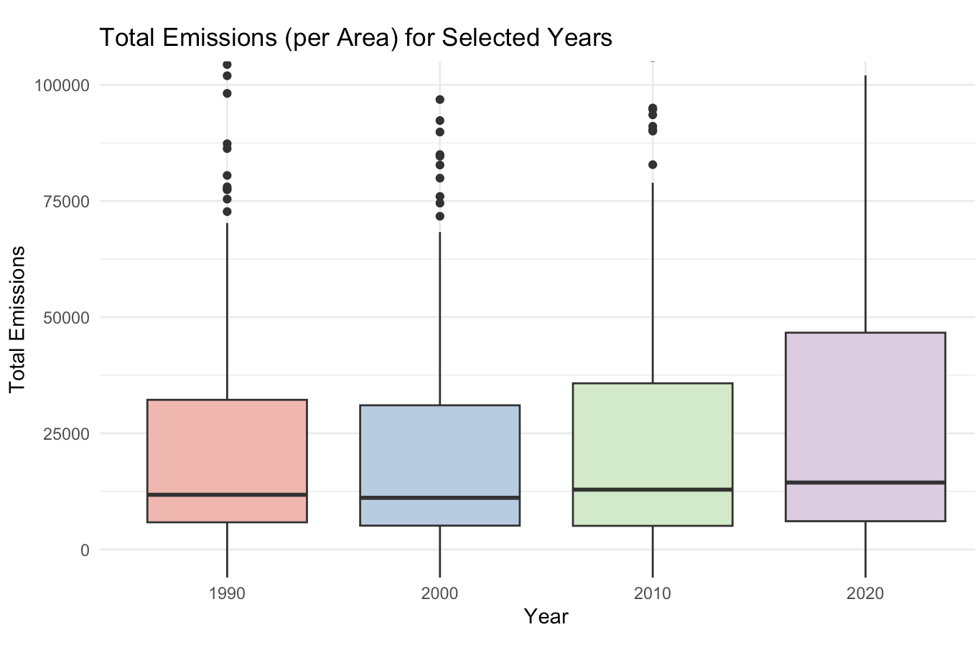
Total emissions
Notes:
What we are ultimately interested in

Slide 9
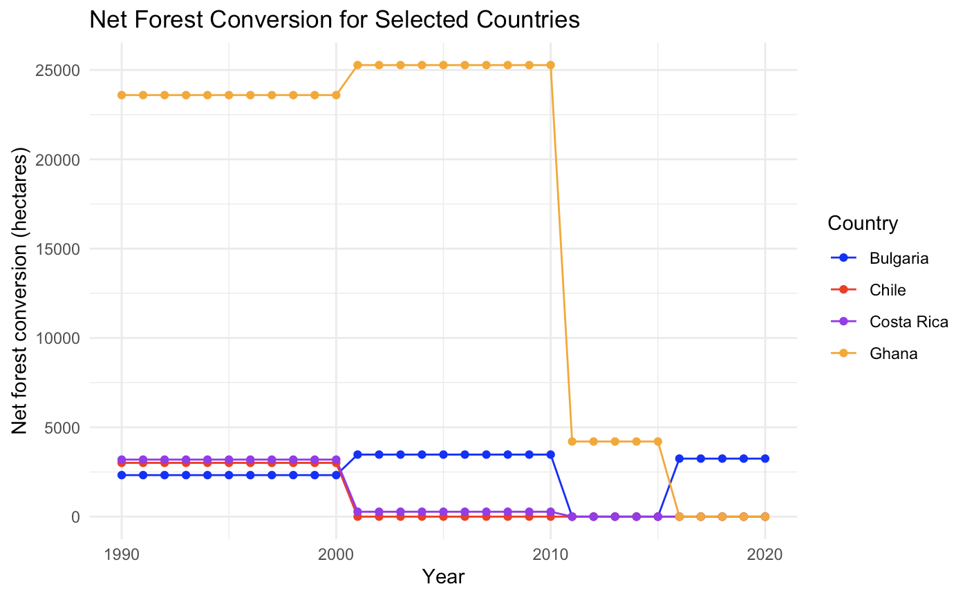
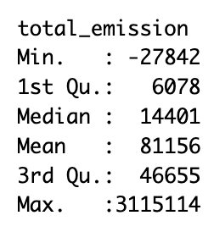
Total emissions
Notes:
What we are ultimately interested in

Slide 10
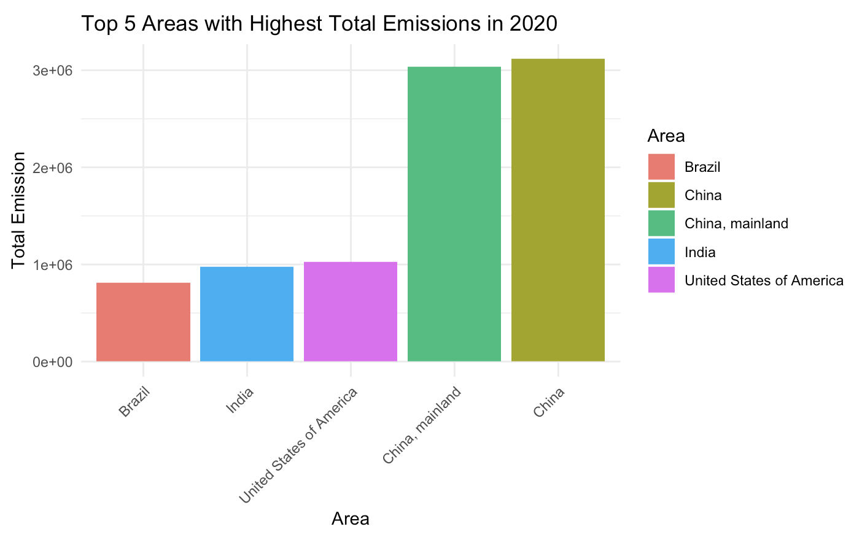
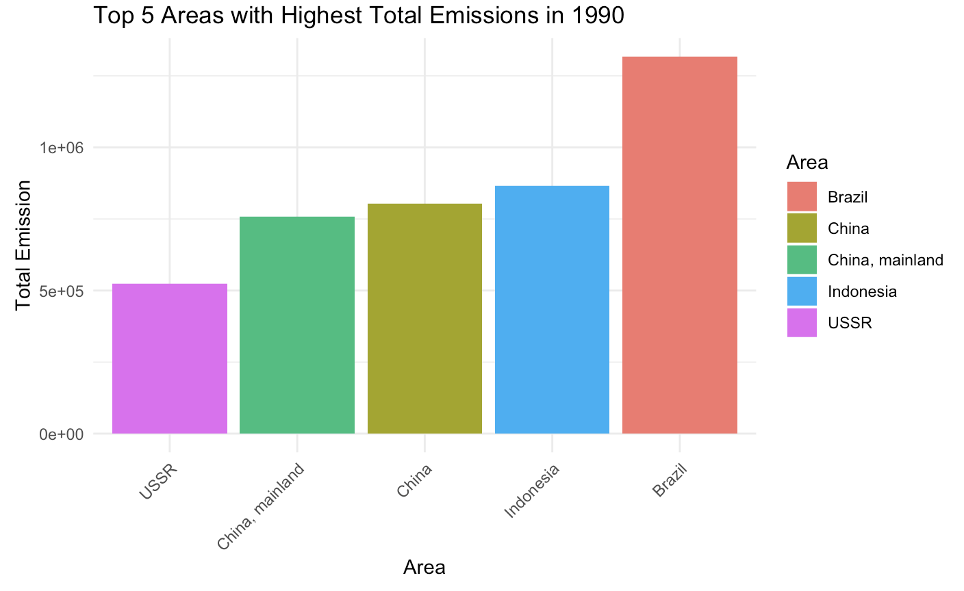
Areas with highest emissions
Notes:
What we are ultimately interested in

Slide 11
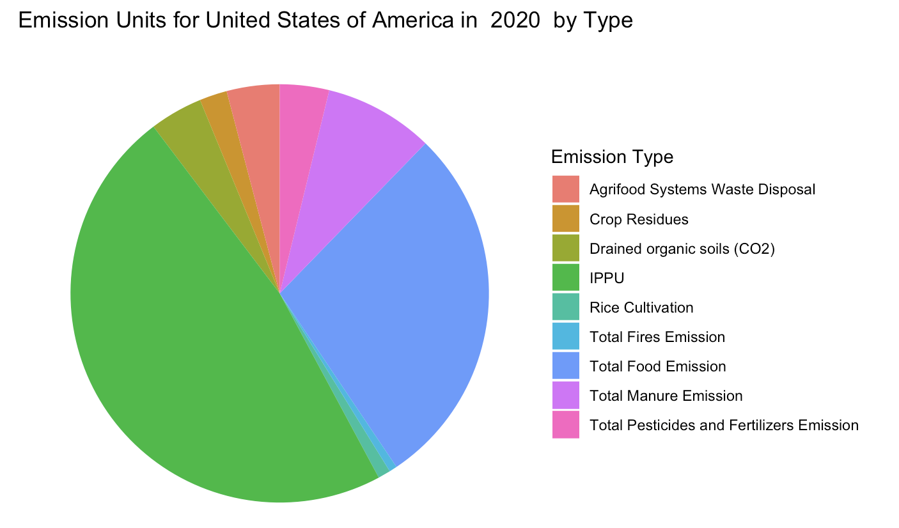
Comparing emissions profiles of top emitters
Notes:
What we are ultimately interested in

Slide 12
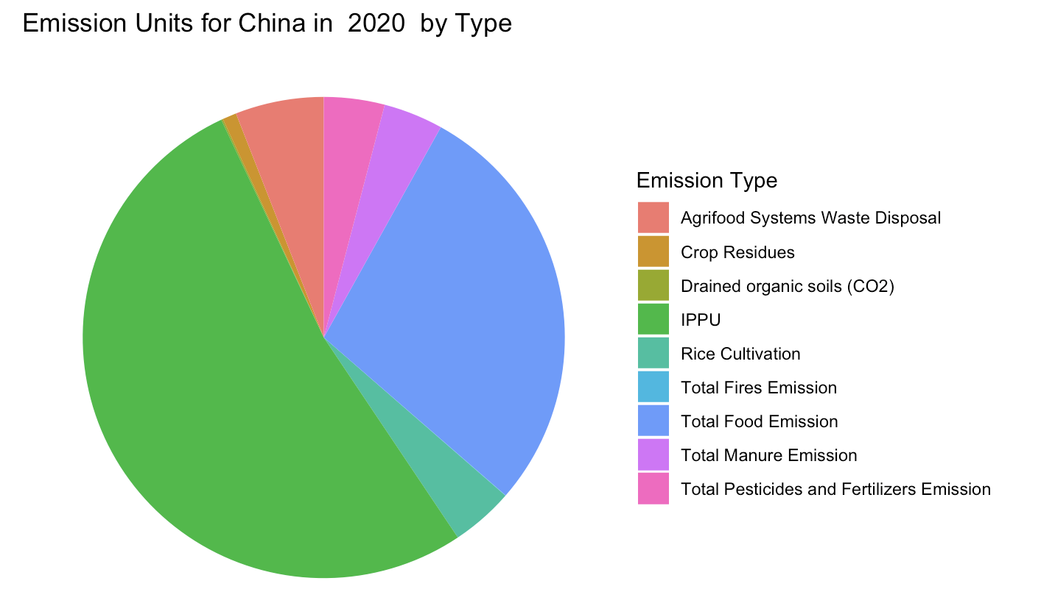
Comparing emissions profiles of top emitters
Notes:
What we are ultimately interested in

Slide 13
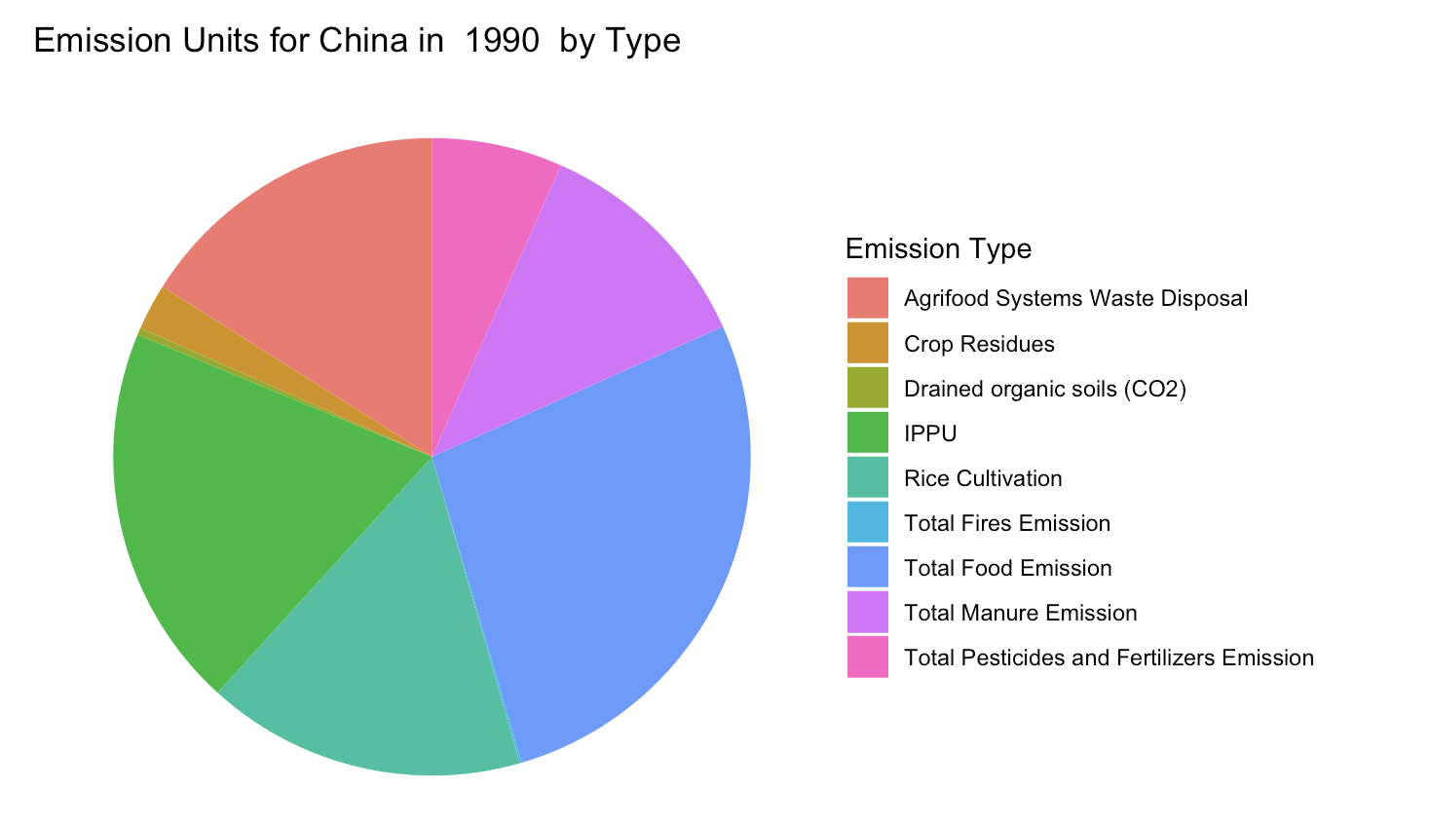
Comparing emissions profiles of top emitters
Notes:
What we are ultimately interested in

Slide 14
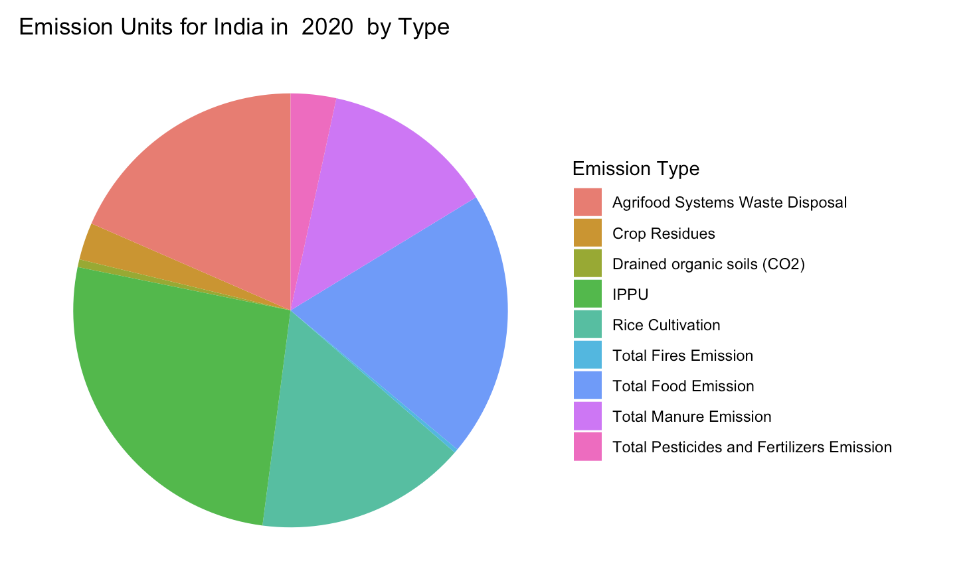
Comparing emissions profiles of top emitters
Notes:
What we are ultimately interested in

Slide 15
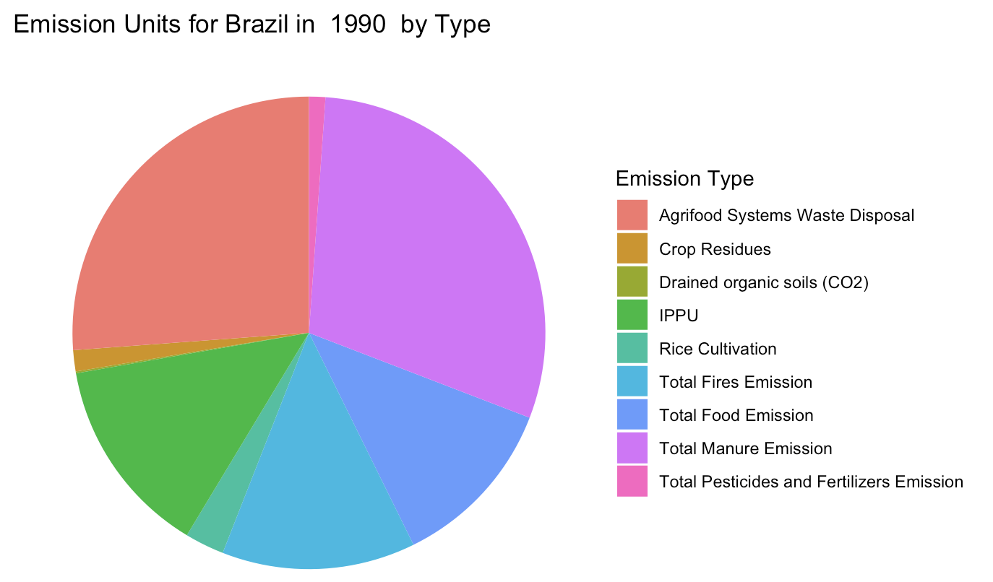
Comparing emissions profiles of top emitters
Notes:
What we are ultimately interested in

Slide 16
Bayesian Conjugate Priors

Slide 17
Beta-Binomial

Slide 18
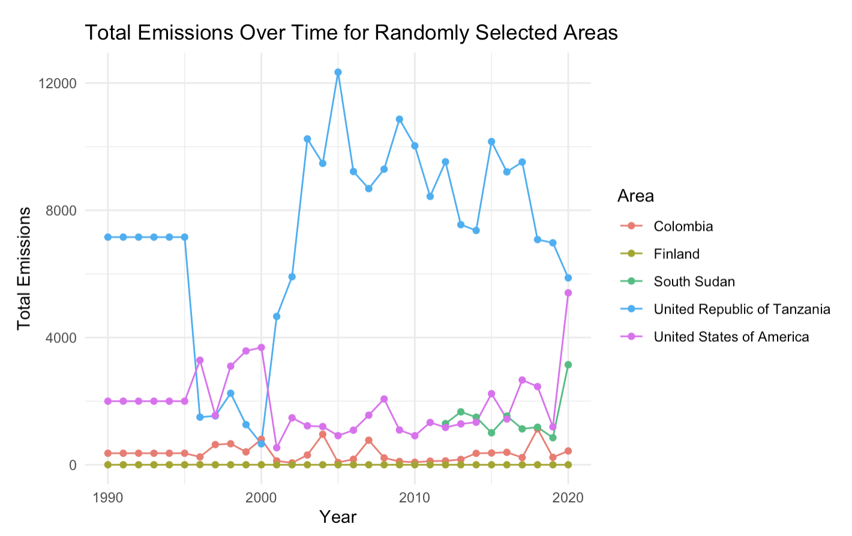
Beta-Binomial (Motivation)
Notes:
Total emissions is highly variable, and in the agri-food industry, there is not a clear story across all countries for if the total emissions increases or decreases.

Slide 19
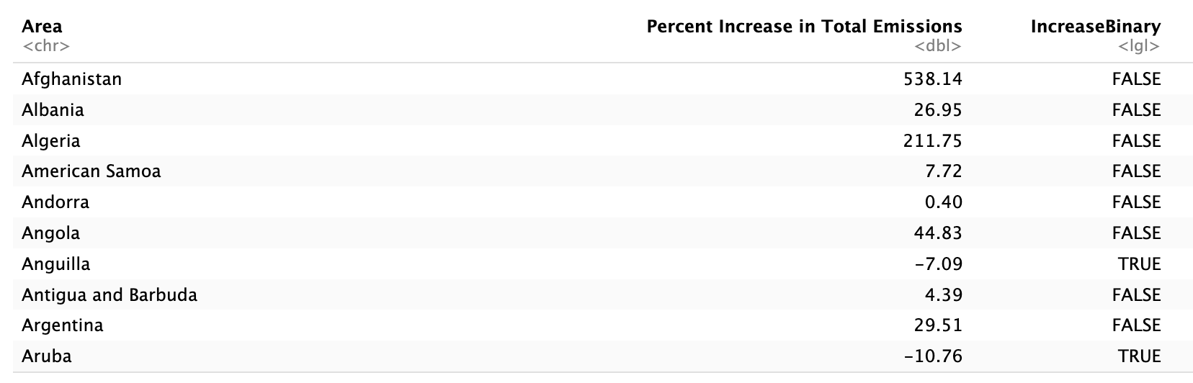
Beta-Binomial

Slide 20
Beta-Binomial
We estimate p, the probability that some given country will reduced their emissions from the agri-food industry in the span of 10 years.
We have N=4646 data points in total.
Within the span of 1990-2020, we observe 1653 decade lags in which total emissions from a country have shown a reduction (35.6%)
Notes:
Try to estimate a probability of occurrence, and you observe binary events.
(We saw earlier that some countries were negative emitters from the agri-food industry in 2020, but we are also interested in the timescale aspect)

Slide 21
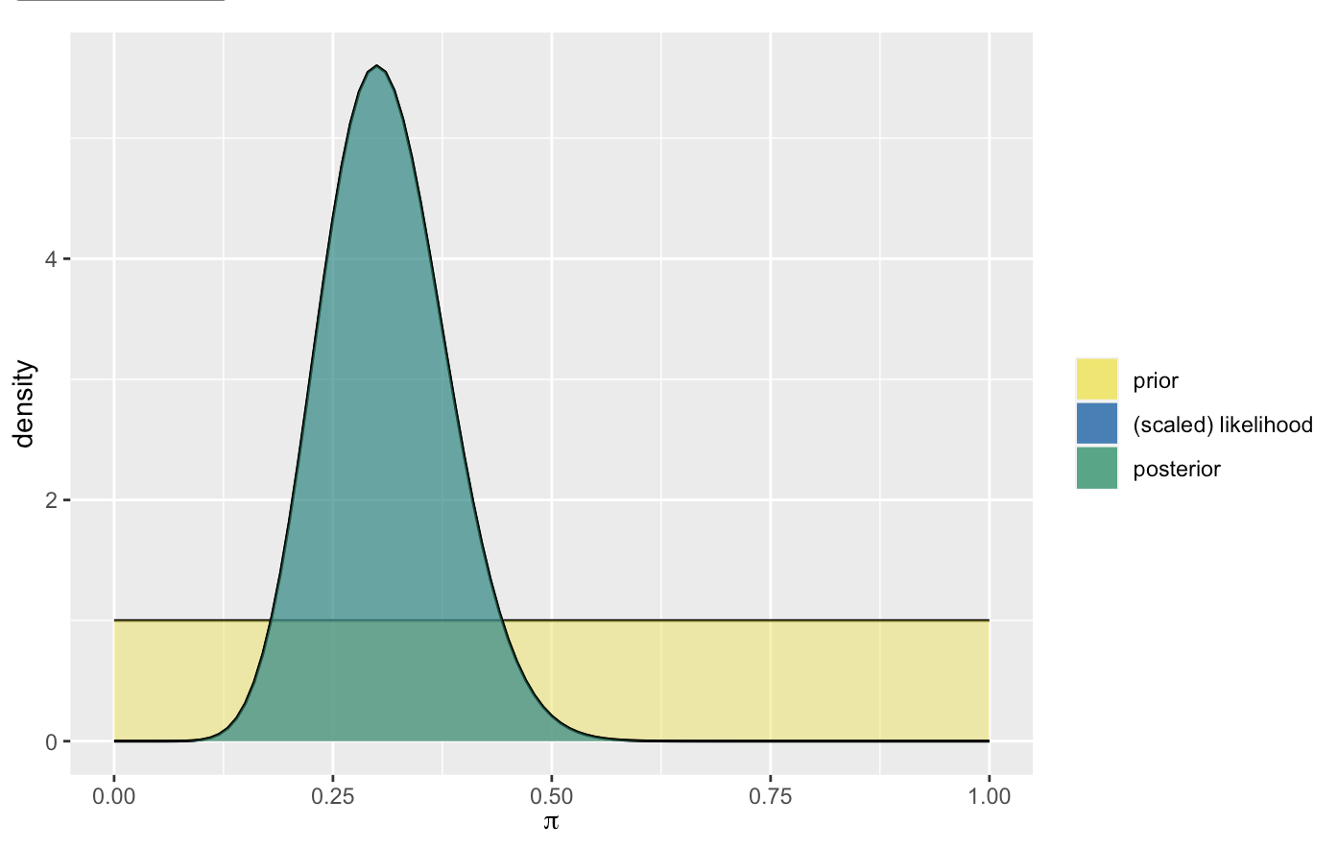
Beta-Binomial
Let’s start with a Beta(1,1) model and observe 40 randomly selected area decade-lags and then see how our posterior model shifts as we incorporate more observations. => 12

Slide 22
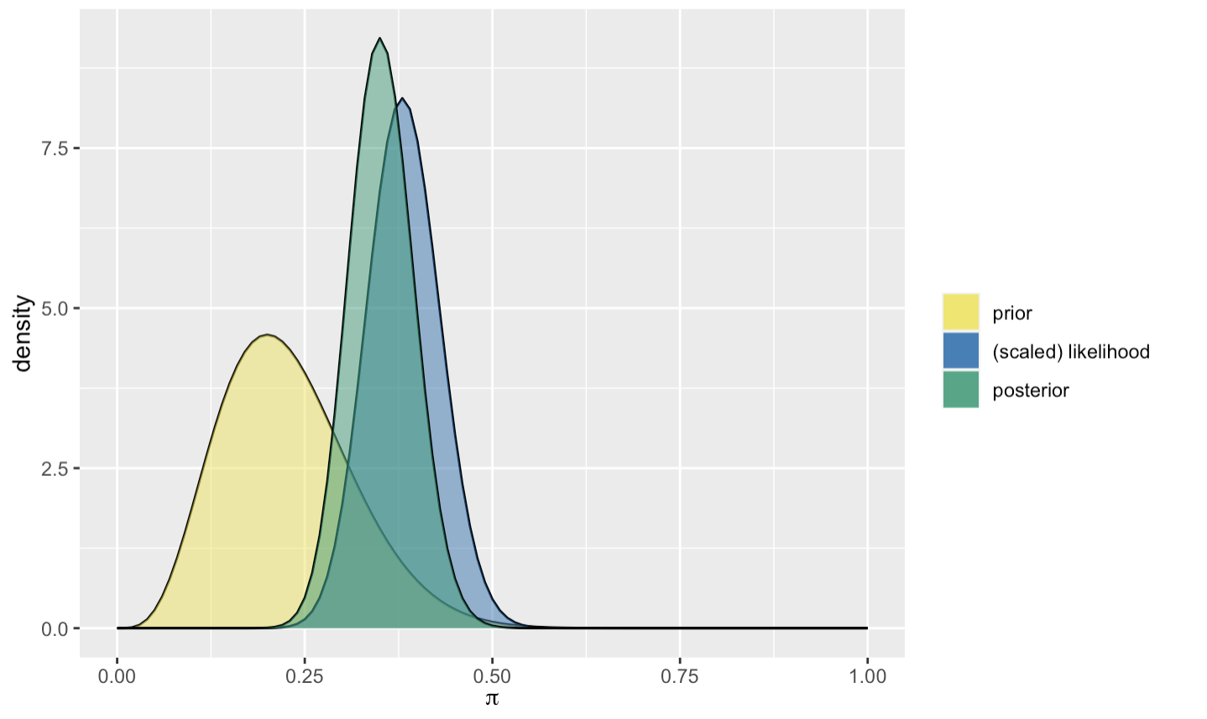
Beta-Binomial
Sampling 100 more area decade-lags (38 successes):

Slide 23
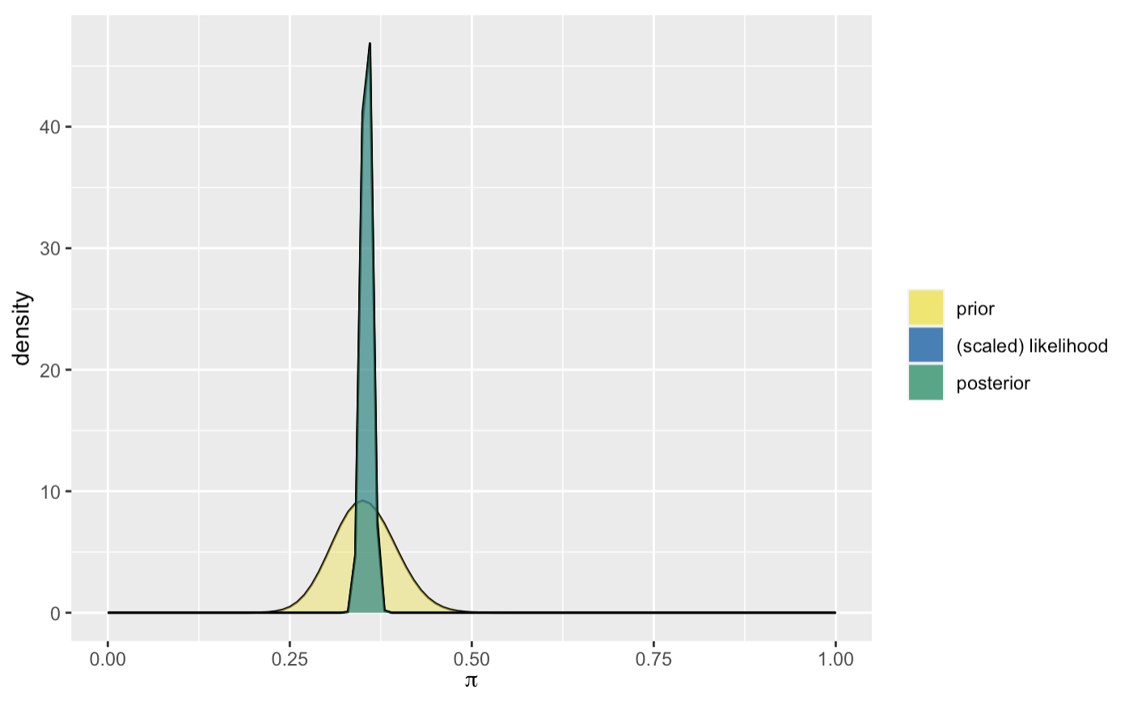
Beta-Binomial
Including the remaining observations (1603/4506 successes)

Slide 24
Gamma-Poisson

Slide 25
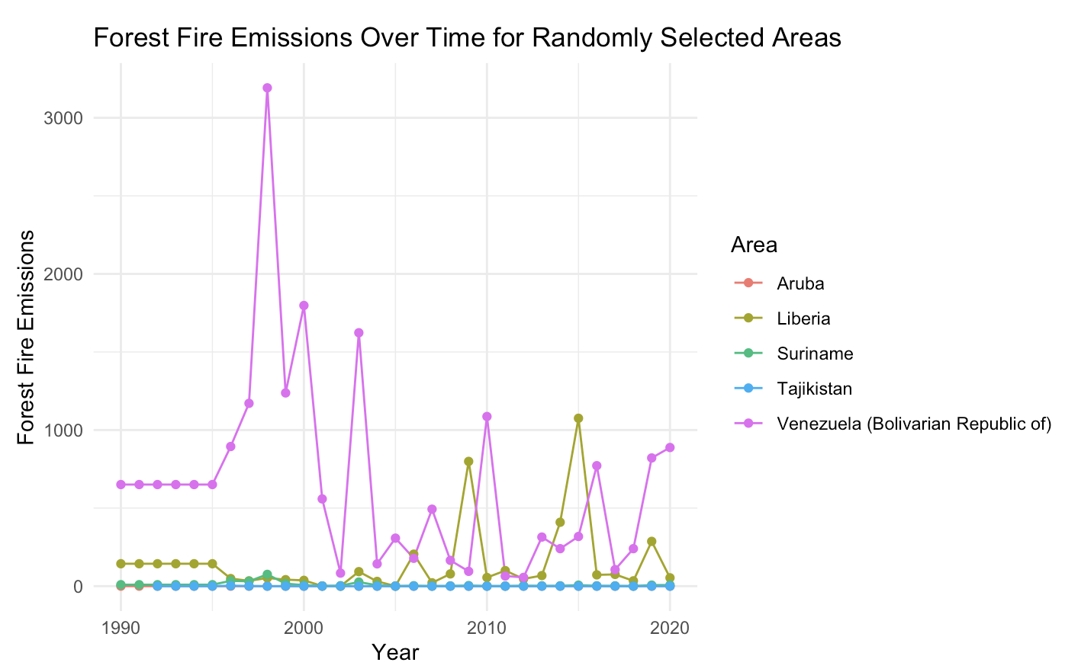
Gamma-Poisson (Motivation)
Notes:
A number of independent events occur in a fixed amount of time or space (rate = λ), and we observe data. We try to estimate λ using a Gamma model.
* I struggled to come up with the independent event because a lot of the data is correlated (on a time level)

Slide 26
Gamma-Poisson
We aim to study the interannual variability of emissions associated with forest fires emissions in South America.
We estimate λ, the rate (occurrences/decade) at which the emissions from forest fires in a given year was drastically different from the previous year.
“Drastically different”: either 2x greater than the previous year or 2x less than the previous year.
Notes:
A number of independent events occur in a fixed amount of time or space (rate = λ), and we observe data. We try to estimate λ using a Gamma model.
* I struggled to come up with the independent event because a lot of the data is correlated (on a time level)

Slide 27
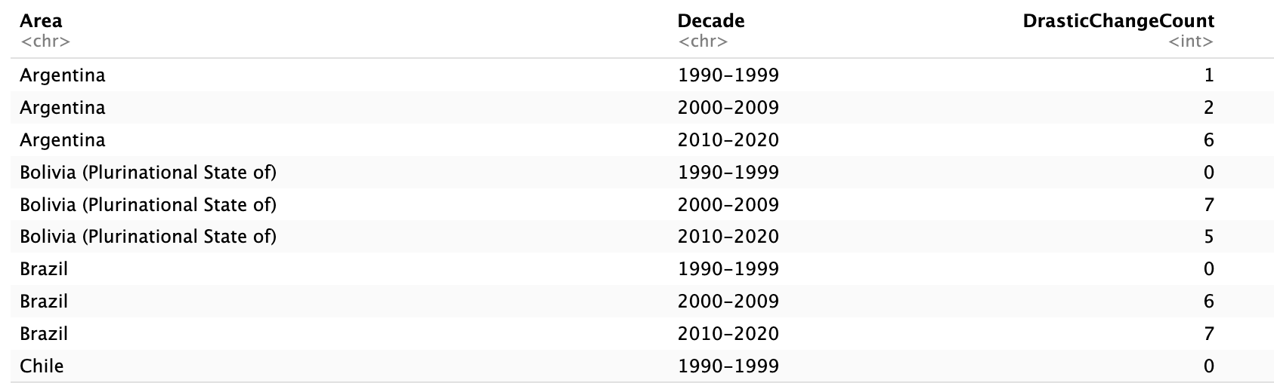
Gamma-Poisson

Slide 28
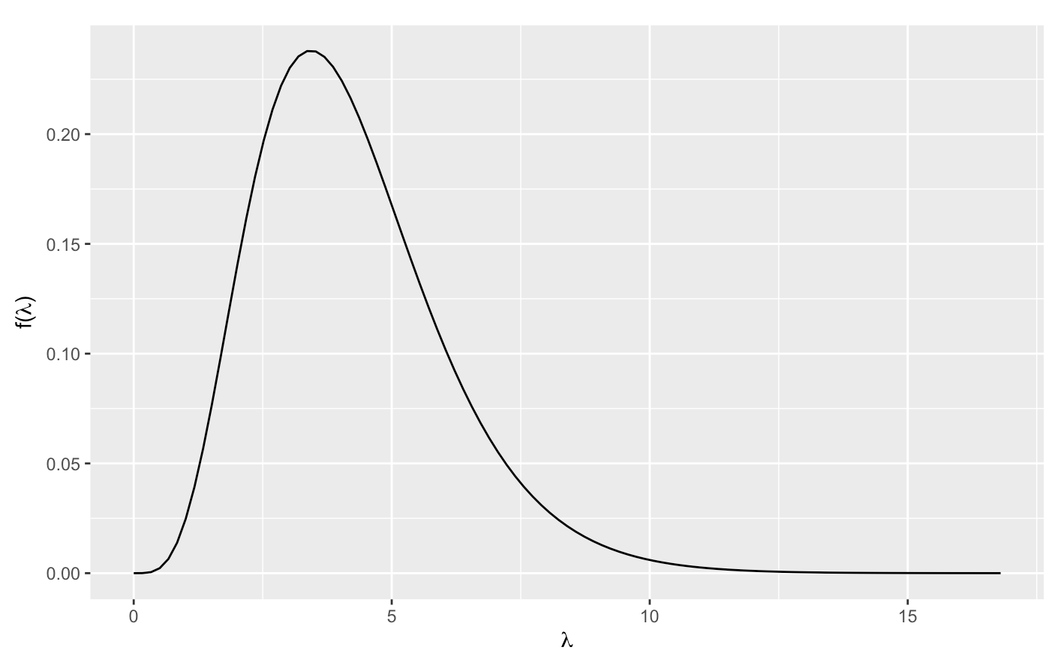
Gamma-Poisson
Our prior is based off of 6 of the 12 South American countries, and we obtain E(λ) = 4.22, SD(λ) = 3.32. Tuning a Gamma prior, we get rate = 1.27 and shape = 5.36.

Slide 29
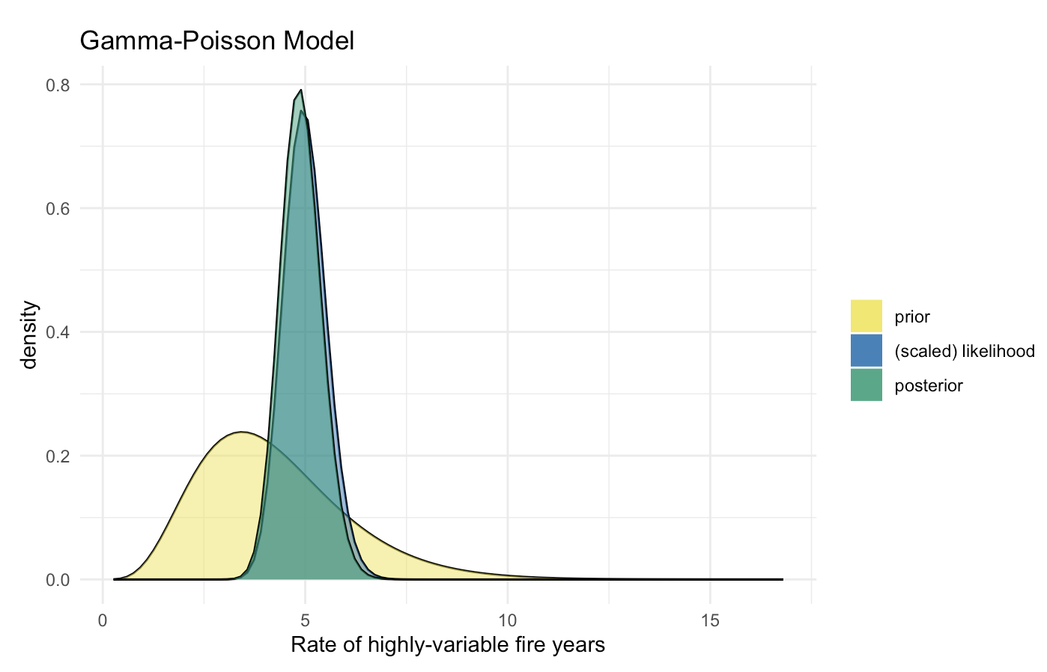
Gamma-Poisson
With observations from the remaining 6 countries (89 occurrences over 18 decades), we get an updated posterior:

Slide 30
Normal-Normal

Slide 31
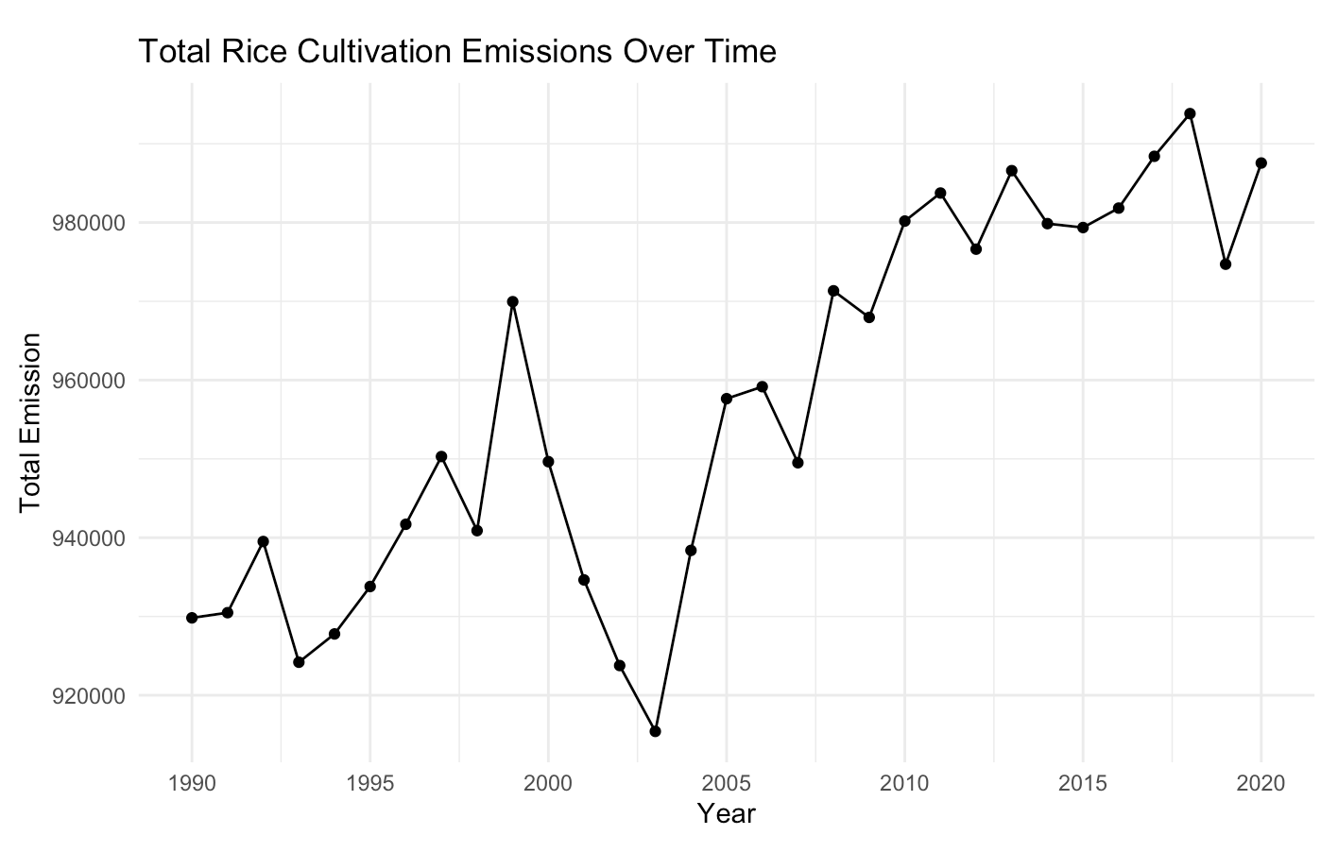
Normal-Normal (Motivation)
Notes:
Try to estimate some parameter with mean and std. We observe different instances of the parameter in order to make our estimation more accurate.

Slide 32
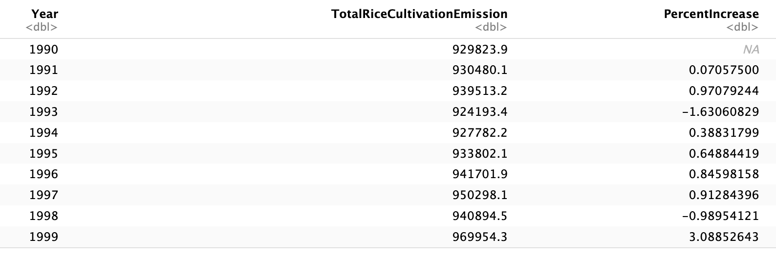
Normal-Normal
Notes:
Try to estimate some parameter with mean and std. We observe different instances of the parameter in order to make our estimation more accurate. Since we see a general upward trend, it would be useful to try to estimate the percent increase between years.

Slide 33


Normal-Normal
We estimate I, the percent increase in global rice cultivation emissions between years.
There are 31 datapoints.
Notes:
Try to estimate some parameter with mean and std. We observe different instances of the parameter in order to make our estimation more accurate. Since we see a general upward trend, it would be useful to try to estimate the percent increase between years.

Slide 34
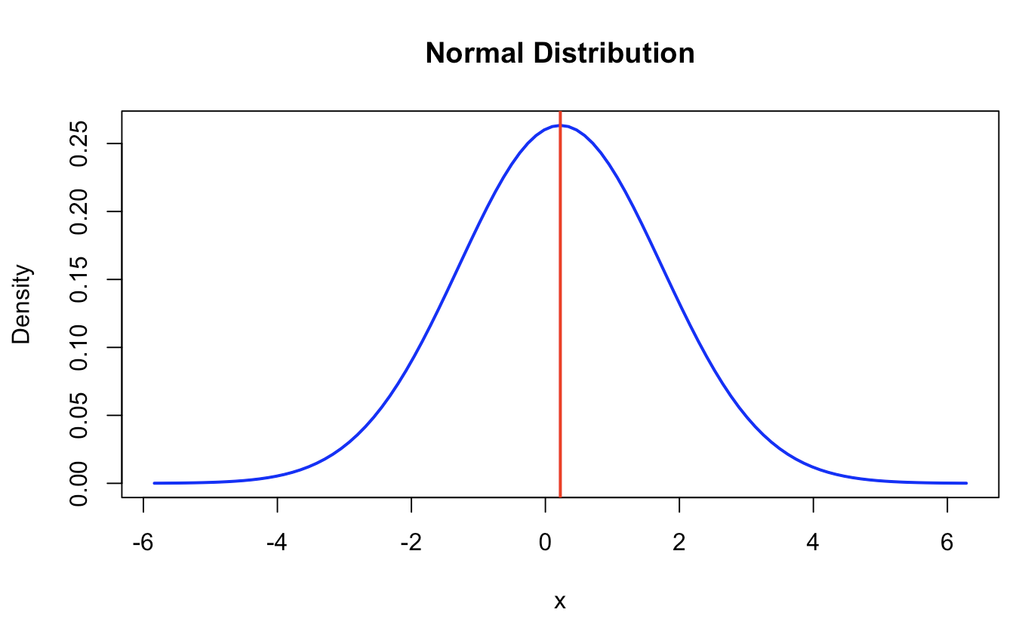
Normal-Normal
Considering only the first 2 decades, we can obtain a normal prior model for I in which mean = 0.223 and sd = 1.515
Notes:
Try to estimate some parameter with mean and std. We observe different instances of the parameter in order to make our estimation more accurate. Since we see a general upward trend, it would be useful to try to estimate the percent increase between years. The prior model is not very informative.

Slide 35
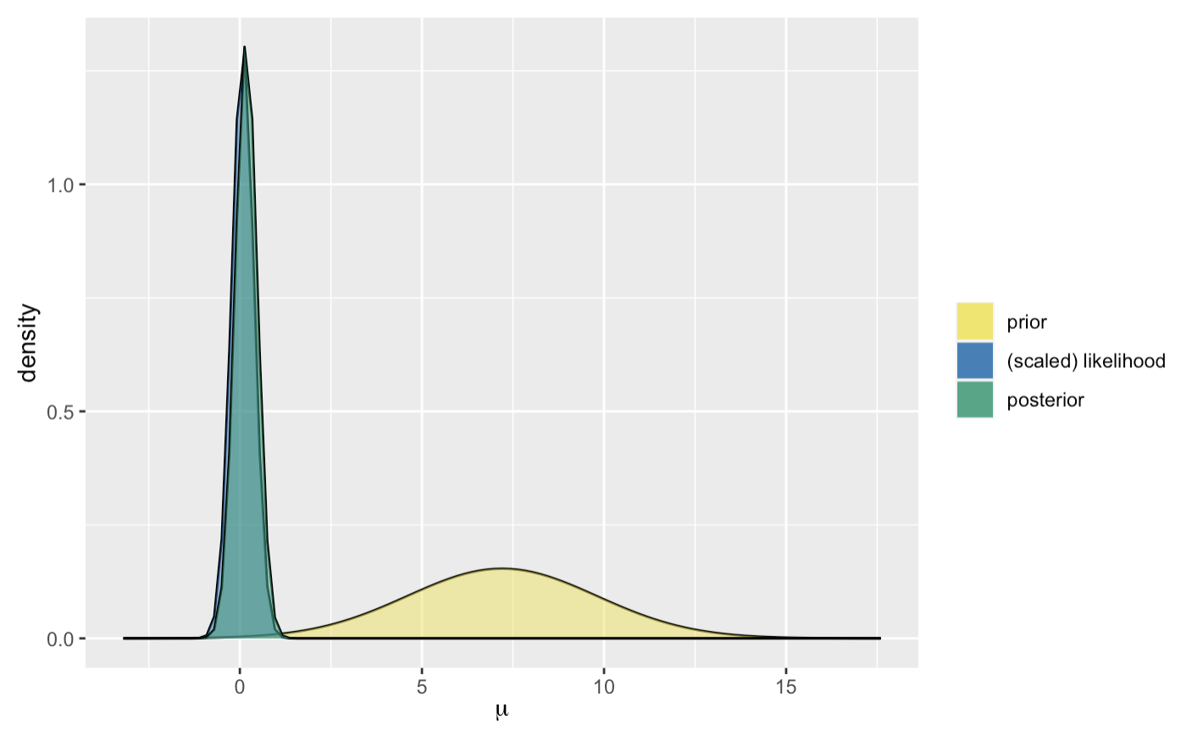
Normal-Normal
With data from the final decade (2010-2020), we obtain:
Notes:
Strong shift! Very informative data

Slide 36
Normal-Normal (Motivation)
Going back to the original plot, this may make sense
Notes:
Try to estimate some parameter with mean and std. We observe different instances of the parameter in order to make our estimation more accurate.

Slide 37
Conclusions & Future Directions

Slide 38
Conclusions
Total emissions from the agri-food industry are increasing, globally
But it is much harder to provide estimates on a country basis
The Beta-Binomial model predicted whether a country would reduce total emissions over the span of 10 years (natural shift)
The Gamma-Poisson model estimated the proportion of highly variable interannual shifts in emissions from forest fires in South America (posterior pivot)
The Normal-Normal model estimated the percent increase in global rice cultivation between years (posterior pivot to a greater extent)

Slide 39
Future Directions
Explore trend differences in developed vs. developing countries
Use an MCMC model in order to make total CO2 estimates based on the entire feature set
Compare MCMC approaches with Bayesian Neural Networks that can take advantage of the robust feature set in order to make future predictions
Data splits: prior is 1990-2010, try to predict 2010-2020

Slide 40
Bibliography & Acknowledgment

Slide 41
Bibliography and Acknowledgment
[1] https://en.wikipedia.org/wiki/Agrifood_systems
[2] https://www.kaggle.com/datasets/alessandrolobello/agri-food-co2-emission-dataset-forecasting-ml/data
I used ChatGPT to help with some of the R code, especially for generating the plots.

